Slide 1


Center of Excellence for
Building Decarbonization (CEBD)
Beneficial Electrification’s Role
in Building Decarbonization

Slide 2

Agenda
Introduction
Moving Towards a Low Carbon Electric Grid
Exploring Beneficial Electrification
Considering Electric Alternatives
Retrofit Challenges
ASHRAE Update

Slide 3

Introduction

Slide 4

ASHRAE’s position…
Eliminating GHG emissions from the built environment is essential to address climate change
Notes:
ASHRAE’s position is simple. Eliminating GHG emissions from the built environment is essential to address climate change.

Slide 5
ASHRAE goals…
2030
The global built environment must halve its 2015 GHG emissions
All new buildings must be NZE
Widespread EE retrofits of existing assets
New construction embodied carbon must be reduced by at least 40%
2050
All new and existing assets must be net zero GHG emissions across the whole life cycle
Notes:
By 2030, the global built environment must halve its 2015 GHG emissions, whereby
all new buildings must be net zero GHG emissions in operation,
widespread energy-efficiency retrofits of existing assets must be well underway, and
embodied carbon of new construction must be reduced by at least 40%.
By 2050, at the latest, all new and existing assets must be net zero GHG emissions across the whole life cycle.

Slide 6
Over 65 California jurisdictions have already adopted policies to promote or require building electrification, and the California Air Resources Board has approved a strategy to ban the sale of gas heating and water heating equipment statewide starting in 2030.
EXCEPTIONS:
Application for a building permit is submitted, accepted by the Department of Building and Safety, and building permit application fees are paid prior to April 1, 2023.
Cooking equipment contained within kitchens located in a public use area, as defined in the California Building Code Chapter 2, such as restaurants, commissaries, and cafeterias provided the electrical infrastructure is installed in accordance with Section 99.05.106.14.1.
Gas-powered emergency life-safety systems, including emergency backup.
Gas-powered process equipment in I-2, F and L Occupancy Groups provided the electrical infrastructure is installed in accordance with Section 99.05.106.14.1.
California
Direction
Transition
to
All-Electric Buildings
Los Angeles Municipal Code
99.05.106.14. All-electric buildings. All newly constructed buildings shall be all-electric buildings.

Slide 7

Moving Towards a
Low Carbon Electric Grid

Slide 8
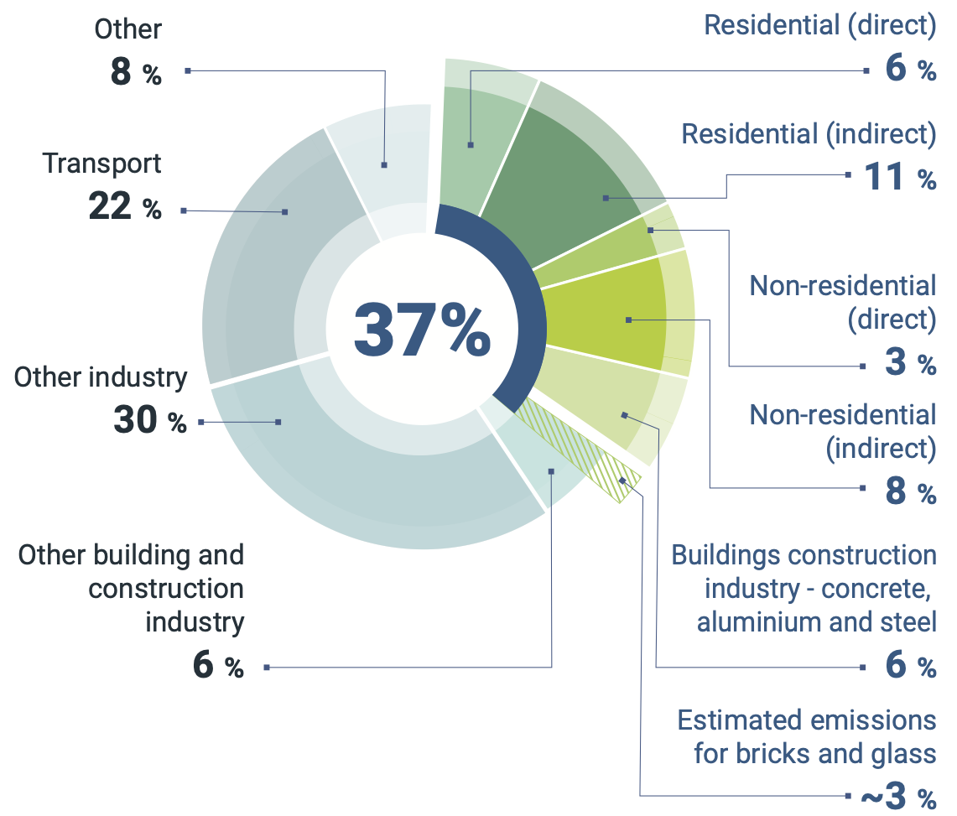
Global building sector energy-related CO₂ emissions,
2021
Source: IEA 2022. All rights reserved. Adapted from "Tracking Clean Energy Progress" (IEA 2022f), https://www.unep.org/resources/publication/2022-global-status-report-buildings-and-construction
Notes:
I’ll start by suggesting the easiest way to save Scope 1 and Scope 2 emissions is by turning off systems that do not need to operate at certain times. I often see central heating systems running at full supply temperature in the summer months because they have decided to connect their small domestic hot water loads to the system.
Direct energy-related emissions from buildings comprised 38% of the building sector, while indirect emissions were 62%.
As we move towards a low-carbon electric grid, building owners NEED assurance that electrification will reduce GHG emissions. As you will learn, these calculations are not simple when considering whole life carbon impacts.

Slide 9
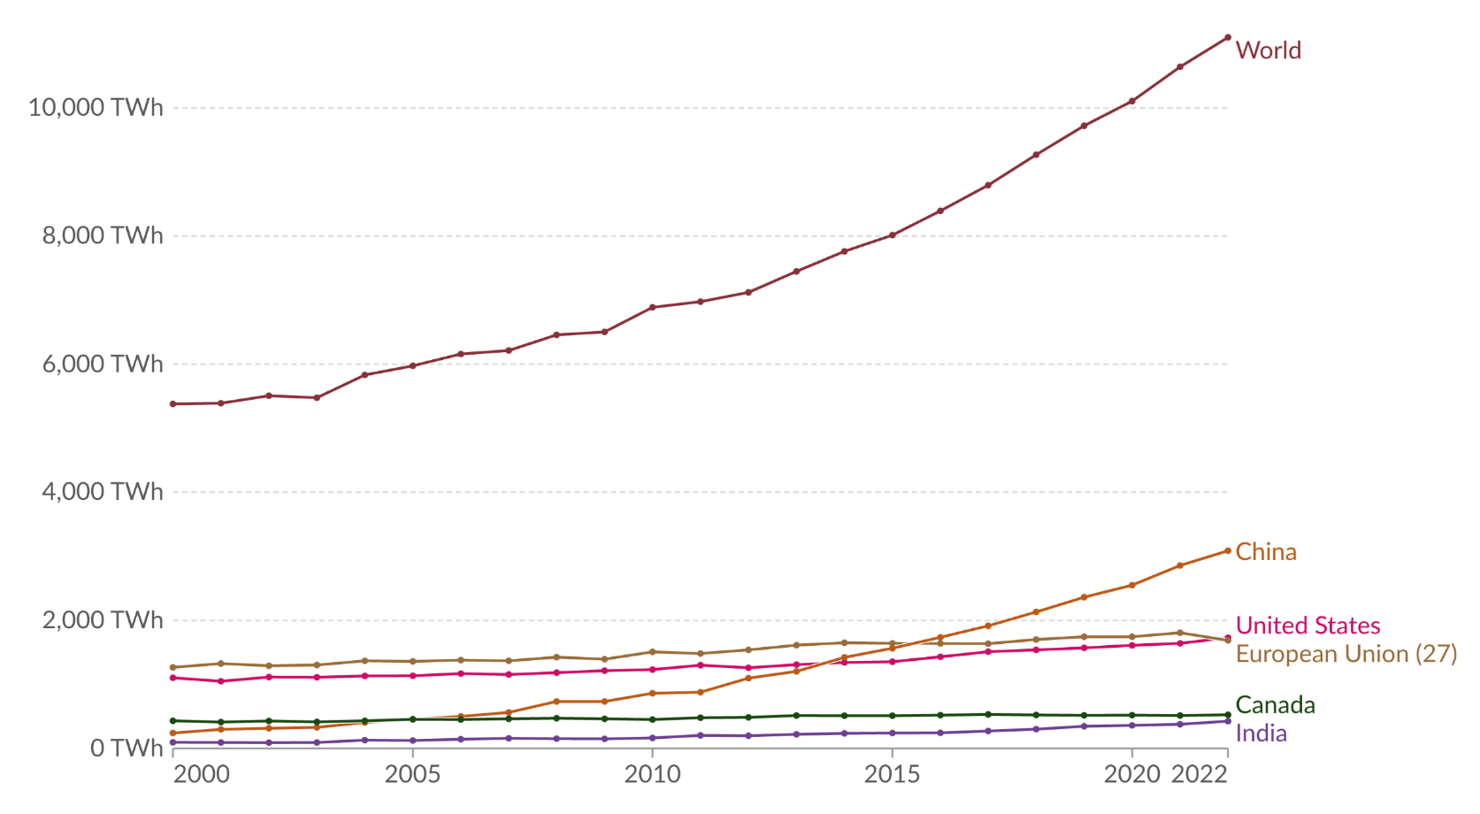
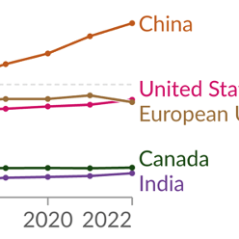
Electricity generation from low-carbon sources, 2000 to 2022
Low-carbon electricity is the sum of electricity generation from nuclear and renewable sources
Source: Ember - Ember - Yearly Electricity Data (2023); Ember - European Electricity Review (2022); Energy Institute - Statistical Review of World Energy (2023), OurWorldInData.org/energy
Notes:
Low-carbon electricity sources will be essential to reduce indirect GHG emissions from the building sector.
Low-carbon electricity can come from nuclear or renewable sources such as hydropower, solar, wind, and geothermal.
The contribution of each varies from country to country.
Globally, 39% of our electricity came from low-carbon sources in 2020.
But there is a lot of variation in low-carbon electricity production worldwide.
World electricity generation has added roughly 5700 TW of low-carbon electricity generation since 2000,
increasing it by 106% in the past 22 years.
China accounted for roughly half of the global low-carbon electricity generation growth during that period. China is the only nation on track to meet its 2030 target.
The U.S. and India were the furthest off from their targets in 2022, adding only 46% and 57% of what was needed to meet their 2030 targets, respectively.

Slide 10
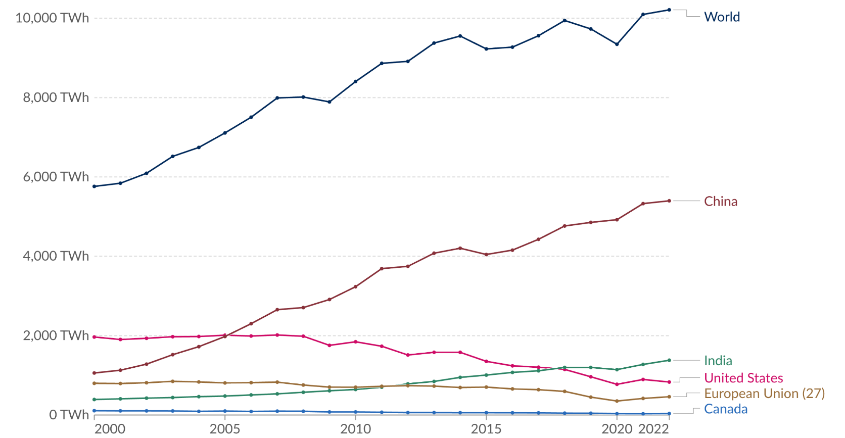
Electricity generation from coal, 2000 to 2022
Measured in terawatt-hours
Source: Ember - Ember - Yearly Electricity Data (2023); Ember - European Electricity Review (2022); Energy Institute - Statistical Review of World Energy (2023), OurWorldInData.org/energy
Notes:
We will need to figure out how to substantially reduce emissions from the world’s reliance on electricity generation from coal.
As we look for solutions, it is important to understand why we have relied on coal in the past.
Coal has been a reliable and affordable energy source. It is abundant and easy to extract and relatively inexpensive to transport.
Additionally, it is a very efficient fuel source, meaning that a large amount of energy can be produced from a small amount of coal.
As we look to reduce GHG emissions, coal generation produces more than double the GHG
emissions when compared to combined cycle natural gas generation.
World electricity generation added roughly 4450 TW of coal electricity since 2000.
Many countries have decreased their coal generation during this period.
China’s growing economy added roughly 5600 TW of coal generation since 2000,
slightly more than the amount of low-carbon generation they added during the same timeframe.

Slide 11
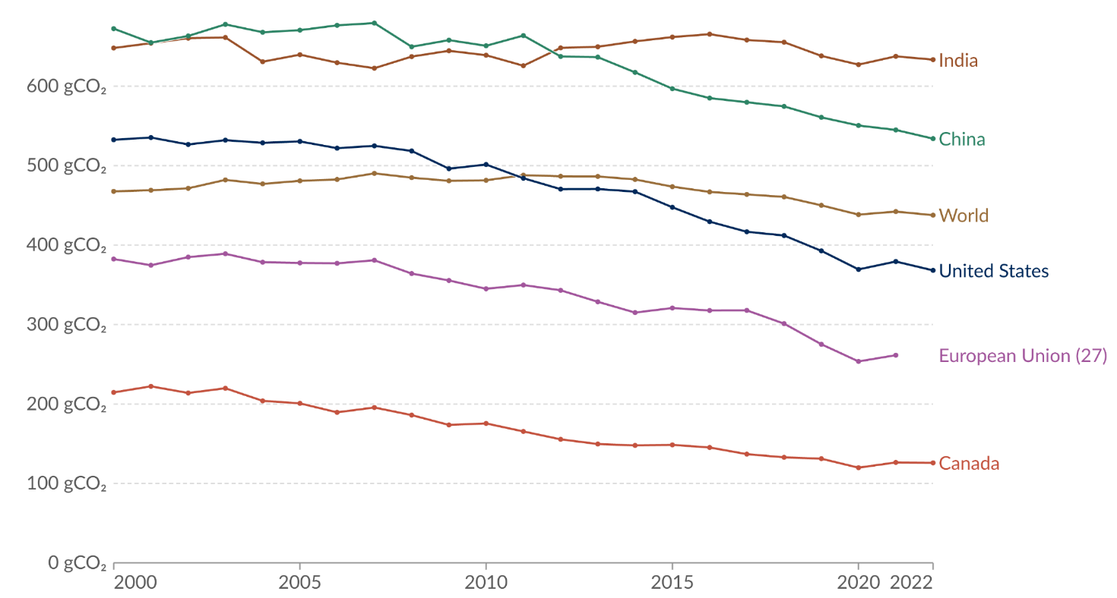
Carbon intensity of electricity, 2000 to 2022
Carbon intensity is measured in grams of carbon dioxide-equivalents emitted per kilowatt-hour of electricity
259 gCO₂e
226 gCO₂e
NG boiler
80% eff
NG boiler
70% eff
Source: Ember - Yearly Electricity Data (2023); Ember - European Electricity Review (2022); Energy Institute - Statistical Review of World Energy (2023)
OurWorldInData.org/energy
Source: EPA Emission Factors for Greenhouse Gas Inventories
Notes:
Carbon intensity on this chart is shown in grams of carbon dioxide-equivalents emitted per kilowatt-hour of electricity generated.
The electric grid carbon intensity has been trending downward since 2010 in many parts of the world.
Much of the reduction is due to the rapid increase of low-carbon generation and natural gas generation replacing coal generation.
Economics will continue to play a critical role in the overall solution sets as we transition towards low-carbon generation.
The energy around the globe must be accessible and affordable.
<click> The GHG carbon intensity from an 80% efficient natural gas boiler is shown. This is gCO2/kWh of output.
<click> The boiler’s actual annual operating efficiency is closer to 70% when accounting for off-standard stack losses.
The electric grid carbon intensity values typically increase by 5% to account for the electrical distribution system losses to the building.
This is why efficient electrification of heat loads will be required using heat pump technology.
A heat pump with an operational COP of 2.0 or 200% efficiency would cut the electricity carbon intensity in half per kWh of heating
Electric resistance technology would generate more emissions than natural gas boilers in many areas of the world.

Slide 12


Carbon intensity of electricity, 2000 to 2022
Carbon intensity is measured in grams of carbon dioxide-equivalents emitted per kilowatt-hour of electricity
What will happen
in the next 25 years?
2050
Source: Ember - Yearly Electricity Data (2023); Ember - European Electricity Review (2022); Energy Institute - Statistical Review of World Energy (2023)
OurWorldInData.org/energy

Slide 13
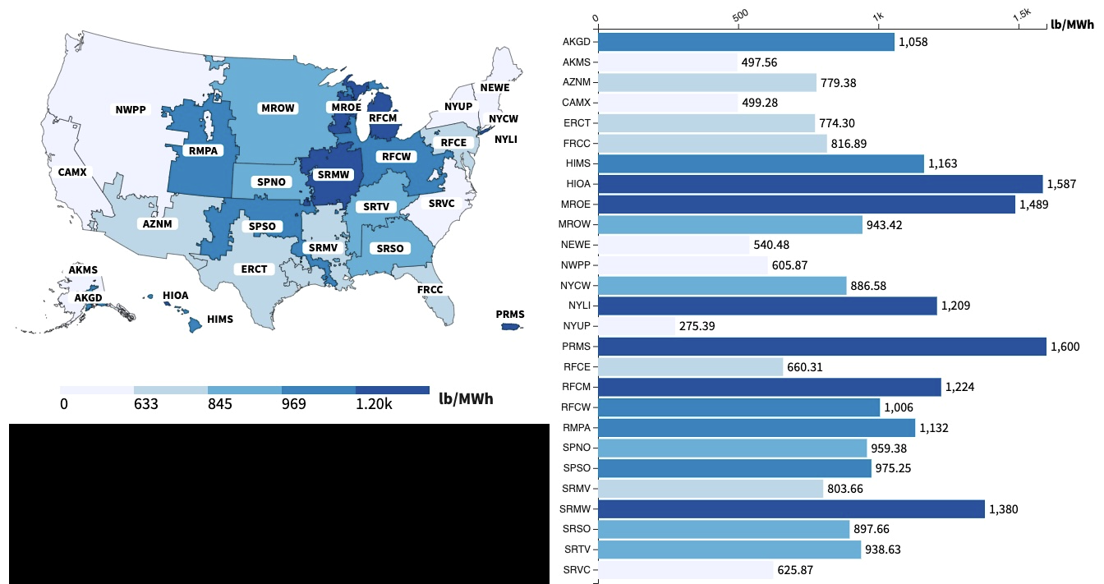
U.S. electricity CO₂e output emission rate
by eGRID subregion, 2022
2022 U.S.
average
828 lbsCO₂e/MWh
376 gCO₂e/kWh
0 287 383 440 544 g/kWh
Source: EPA eGRID https://www.epa.gov/egrid/data-explorer
Notes:
We have been reviewing the global and country electricity carbon intensity trends.
We will now explore this inside a country. This slide uses the United States as an example.
These electric grid carbon emission factors vary substantially across the various subregions in each country.
In 2022, the average United States electricity emission factor was roughly 376 gCO2e/kWh,
but the subregions vary from 124-725 gCO2e/kWh. This is a range of 6:1.
Location and generation sources can vary substantially for electricity grid carbon emissions.

Slide 14
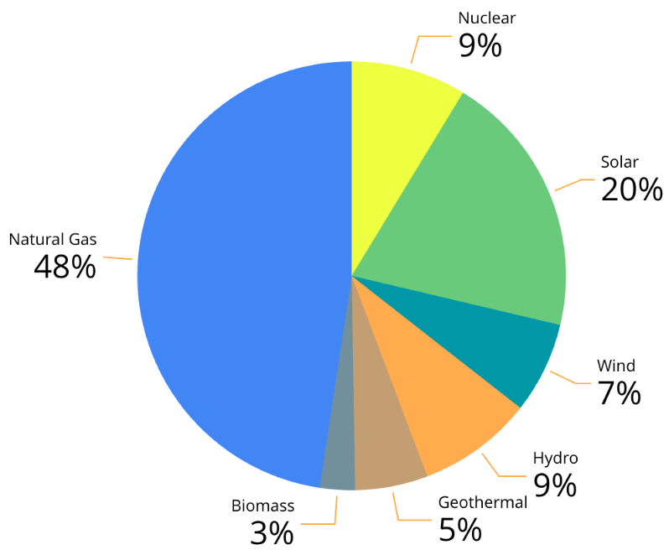
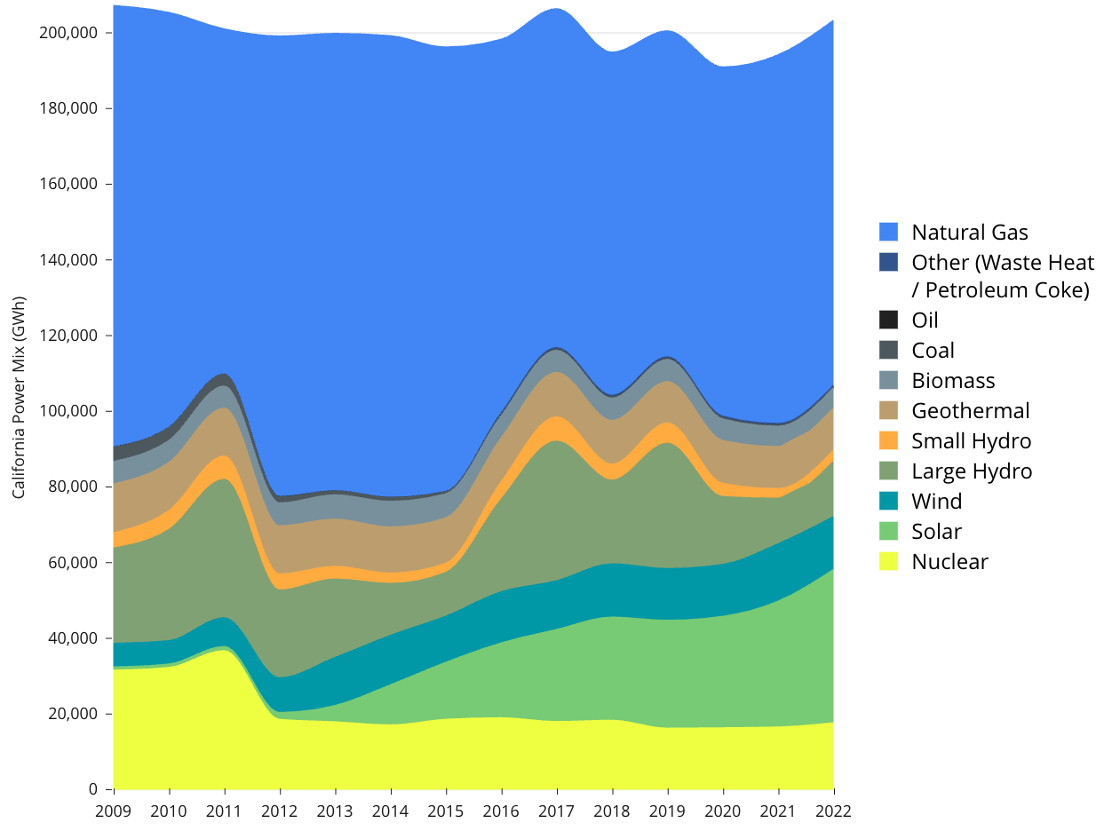
California Power Mix, 2009 to 2022
2022 California Power Mix
Source: https://www.energy.ca.gov/sites/default/files/2023-10/California_Electrical_Energy_Generation_2001-Current_ADA%20%28for%20web%29.xlsx
Notes:
This is a breakdown of California’s 2022 electricity mix from generation sources. More than 50% of our electricity is generated from low carbon sources.
You can see the trend for the last 14 years. Our nuclear energy dropped in 2012 while solar and wind energy more than made up for that reduction in the past 10 years. Natural gas still has the largest percentage of source generation.

Slide 15
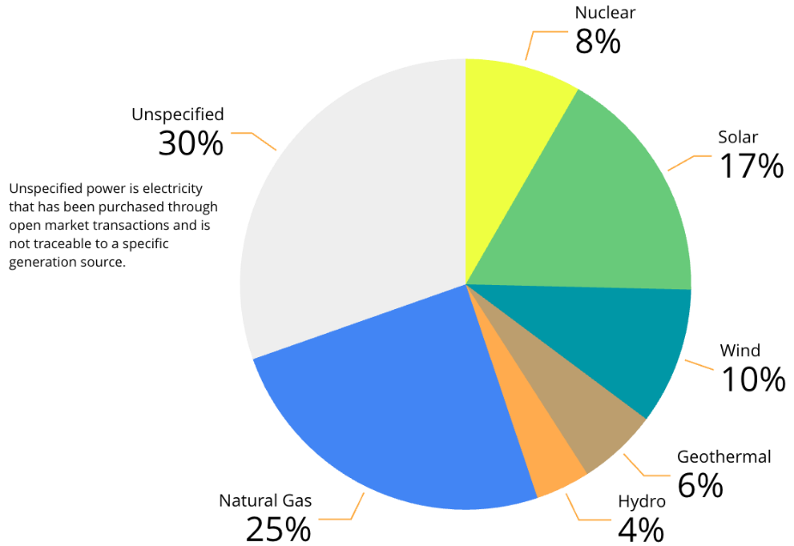
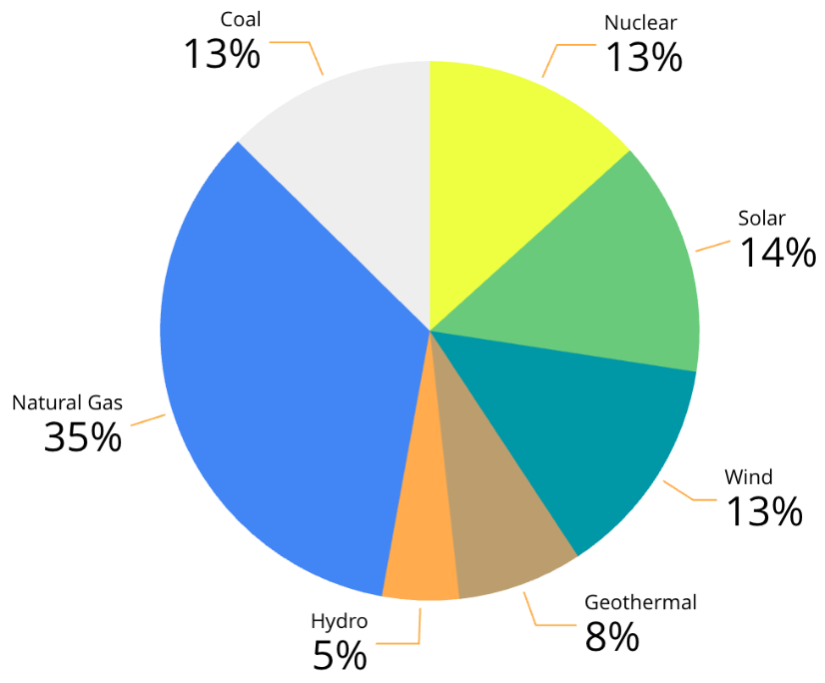
Local Utility Power Content Labels, 2022
Southern California Edison
552 lbs CO₂e/MWh
250 gCO₂e/kWh
LADWP
567 lbs CO₂e/MWh
257 gCO₂e/kWh
Sources: https://sce.com and https://www.ladwp.com/powercontent
Notes:
Let’s break this down to your local utility level. This data is taken from the yearly power content labels. It is essential to understand the carbon content of electricity as we convert from natural gas to electricity.

Slide 16
Exploring Beneficial
Electrification

Slide 17





Slide 18
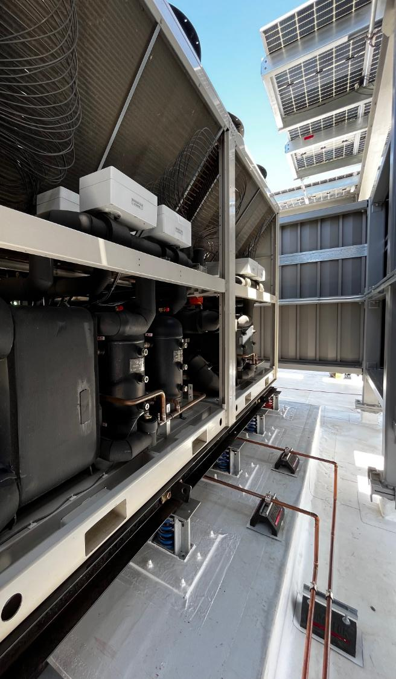
Pillars of Beneficial Electrification
Help the Environment
Energy
Efficiency
Renewable Energy Integration
Improve the Quality of Life
Grid Responsiveness
Save
Money
Reduce overall greenhouse gas emissions
Upgrading buildings to use energy more efficiently
Use of energy generated from renewable sources
Improves IAQ without onsite combustion emissions
Enhancing buildings' ability to respond to grid demands
Potential to reduce building utility costs
Audience
Participation
Notes:
ASK the audience to provide reasons for electrifying buildings before showing the text.

Slide 19

Building Decarbonization
  whole life = operational
  + embodied

Slide 20

Building whole life cycle carbon stages
Embodied carbon
Circular Economy
Product
Stage
(A1 – A3)
Construction
Stage
(A4 – A5)
Use
Stage
(B1 – B7)
End of Life
Stage
(C1 – C4)
Beyond the Building
Life Cycle Stage
(D)
Benefits and Loads
Reuse-
Recovery-
Recycling-
Potential
A4: Transport to site
A1: Raw material supply
A5: Construction and installation process
A2: Transport to factory
A3: Manufacturing
C3: Waste processing
B1: Use
C4: Disposal of waste
B2: Maintenance
B3: Repair
B4: Replacement
B5: Refurbishment
C1: Deconstruction / demolition
C2: Transport to waste processing/disposal
Whole life carbon
Operational carbon
B6: Operational energy use
B7: Operational water use
Source:
Figure based on EN 15978:2011
Notes:
Lately, there has been a lot of discussion around whole-life carbon emissions based on the life cycle of a building.
As we can see from the left side of this figure, building GHG emissions are locked in place as soon as a building is built, even before its operation
[click] This starts with extract, transport to the factory, and manufacture during the product stage
[click] to the construction stage transporting to the site and constructing the building.
[click] We have both embodied and operational emissions during the maintain and use stage.
The operational carbon is energy and water-related emissions during the use of the building.
Equipment replacements and building renewals add additional embodied carbon during this stage.
[click] It doesn't stop there, we also have embodied emissions at the end-of-life stage due to demolishing the building, hauling away the waste materials, and whether we send it to a landfill or recycle.
[click] The last stage is beyond the lifecycle that covers the emissions for reuse and recovery.
[spend some time on this slide – especially at the end – the idea of a circular economy – remember Edward McDonough – Architecture 2030. He gave our keynote at COP27 this year. Edward wrote a book called Cradle-to-Cradle. The circular economy is the same idea. He used the example of nature and specifically a tree as being one of the most sustainable – self sufficient organisms on the planet. It grows, sheds leaves to feed the microorganisms under it to create its own fertilizer and continues to perpetuate itself year after year. There is no waste in nature – the idea behind the circular economy – no waste – everything is recyclable in some way]
Reducing both embodied and operational carbon in buildings is critical to achieving a more sustainable and low-carbon future.
Governments and other organizations are beginning to understand the importance of evaluating means to reduce embodied and operational emissions.

Slide 21
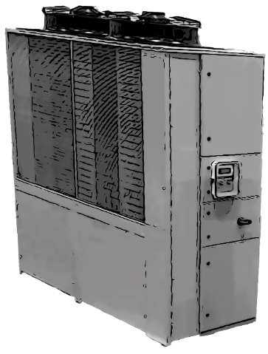
Refrigeration Equipment Greenhouse Gas Emissions
EN 15978
B6: Energy
Operation Carbon
B1: Refrigerant
Embodied Carbon
CO₂e
CO₂e
A1-A5:
Embodied Carbon
CO₂e

Slide 22
Refrigerant Greenhouse Gas Emissions
GHG Emissions =
Refrigerant Charge x Annual Leakage Rate x GWP
  Can calculate it per year in lbs or kg
  Can also calculate it over the life of the building
ASHRAE Fundamentals Handbook Chapter 29, Refrigerants
  Specifies GWP₁₀₀ for various refrigerants using IPCC (2013)
Standard 228 – Standard Method of Evaluating Zero Net Energy and Zero Net Carbon Building Performance
  Specifies annual leakage rates for various system types

Slide 23
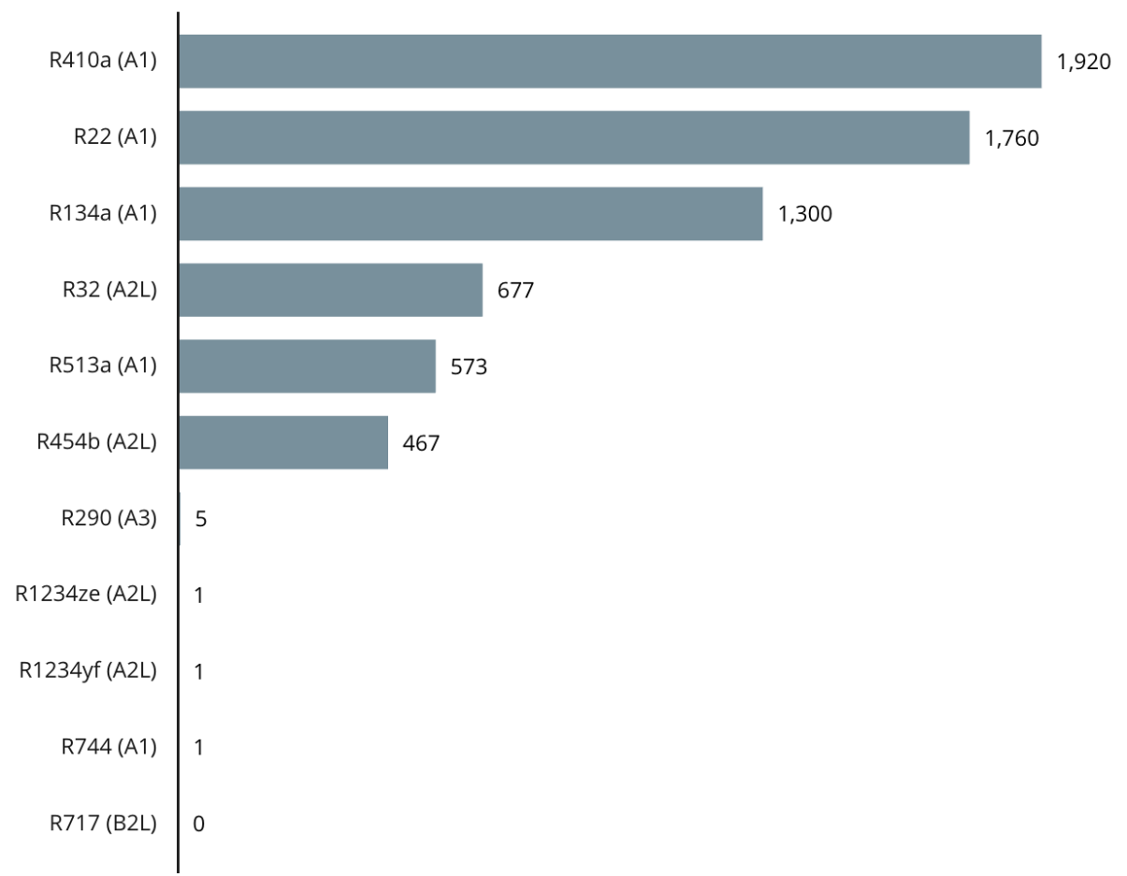
Refrigerant Greenhouse Gas Emissions
GWP of Select Refrigerants, IPCC AR5 (2013)
Propane
*
CO₂
*Breaks down into trifluoroacetic acid (TFA)

Slide 24
Refrigerant Greenhouse Gas Emissions
ASHRAE Standard 228-2023
Typical Annual Refrigerant Leakage Rates by Equipment Type
Equipment Type | Annual Leakage Rate
Water chillers | 5%
Hermetic units | 1%
Rooftop air conditioner | 6%
Residential HP or AC | 2%
VRF | 10%
Commercial condensing units | 15%

Slide 25
Refrigerant Greenhouse Gas Emissions
R410a VRF Example
VRF systems typically use 0.06 to 0.20 kg/m² of refrigerant charge per conditioned floor area.
  0.06 kg/m² refrigerant density is assumed
  R-410a GWP is 1920
  10% annual leakage rate (ASHRAE Std 228)
This would result in 11.5 kgCO₂e/m²-yr or 1,070 gCO₂e/ft²-yr of GHG emissions
CBECS U.S. commercial building average annual heating usage is 2 kWh per ft²-yr, a natural gas boiler would emit roughly 520 gCO₂e/ft²-yr
We should estimate GHG emissions from refrigerant leakage as we electrify building heating systems

Slide 26
Refrigerant Greenhouse Gas Emissions
Reducing Refrigerant Emissions
Use of low-GWP refrigerants
Enhanced energy efficiency
Innovative non-refrigerant technologies
Lower refrigerant volume
Regular maintenance and leak prevention
Refrigerant management and recycling
For ways to reduce refrigerant leakage, refer to REAL Zero booklets at www.realzero.org.uk

Slide 27
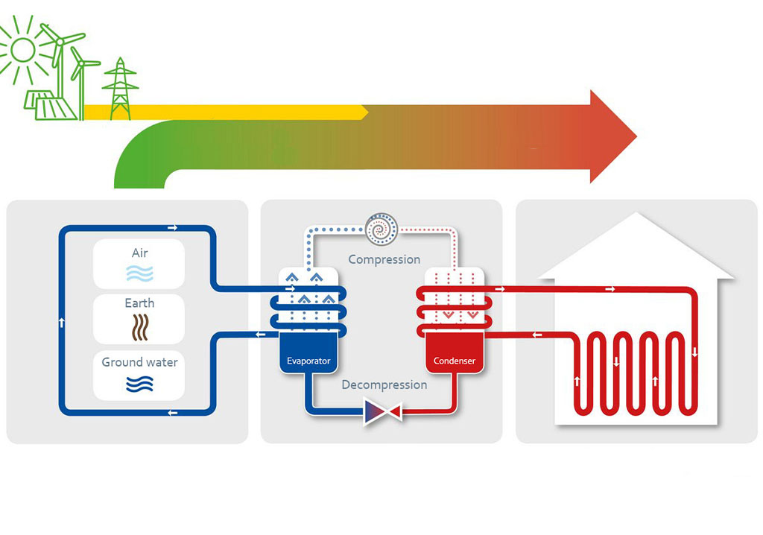
Considering Electric Alternatives

Slide 28
Initial
Considerations
Lower required heating and cooling loads
Energy efficiency
Heat recovery, where possible
System turndown requirements
Understand source and load operating conditions expected throughout the year
Consider thermal storage, where applicable

Slide 29
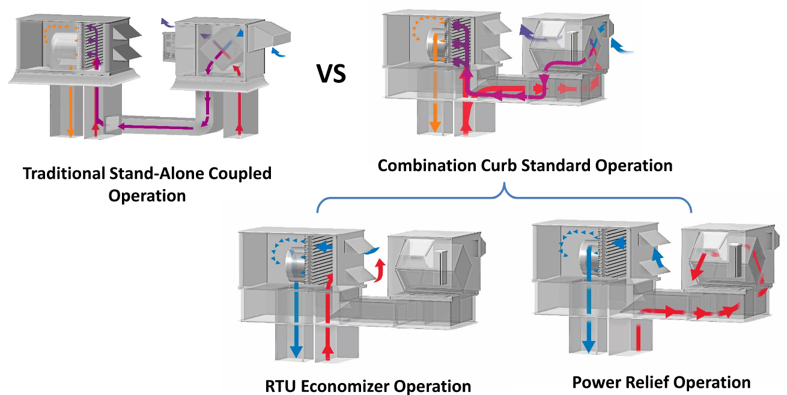
Heat Recovery to Reduce Heating Loads
Ventilation loads are
a substantial portion
of heating loads
55-75%
efficiencies
Source: 2020 ASHRAE Learning Institute Air-To-Air Energy Recovery Applications: Best Practices
Notes:
Air-to-air energy recovery is a very cost-effective and efficient way to recycle waste energy and create superior indoor environments.

Slide 30
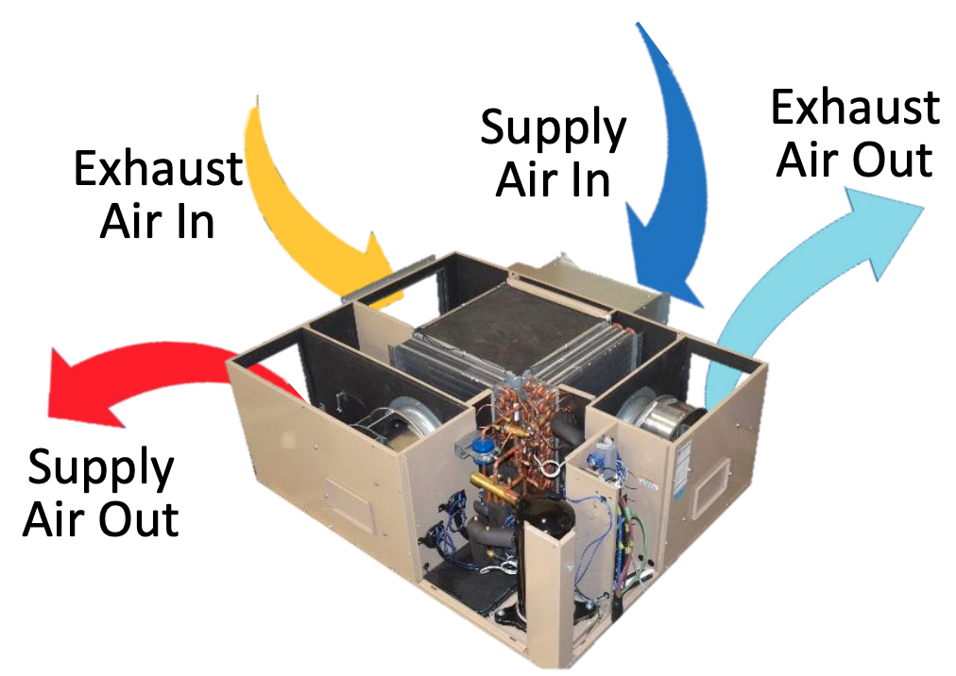
Heat Recovery MA/EA Heat Pumps
Image Source: Transom

Slide 31
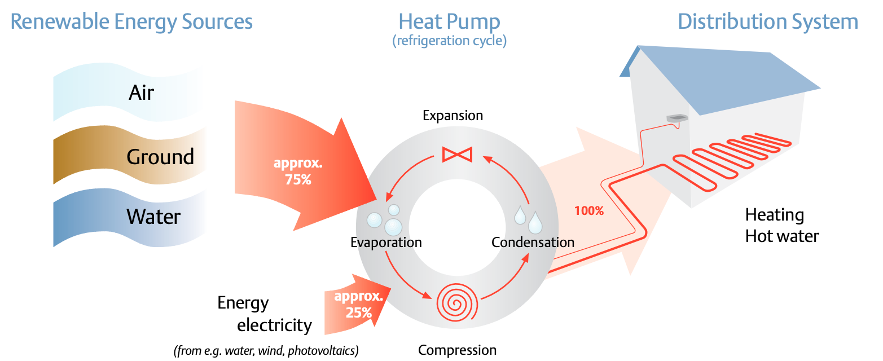
Heat Pump Alternatives
Image Source: Copeland

Slide 32
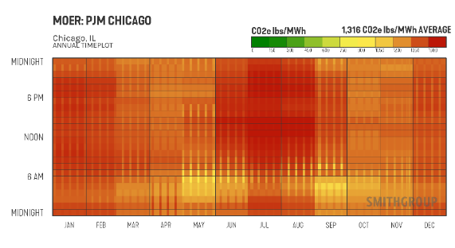
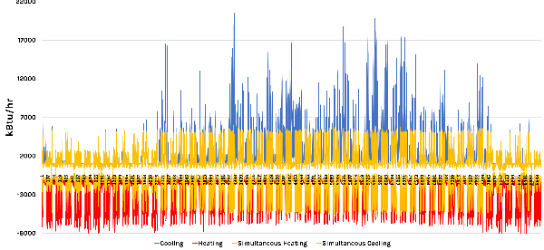
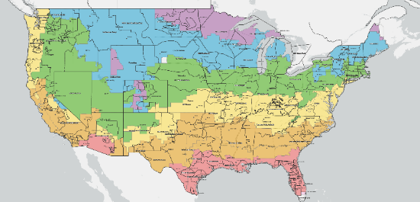
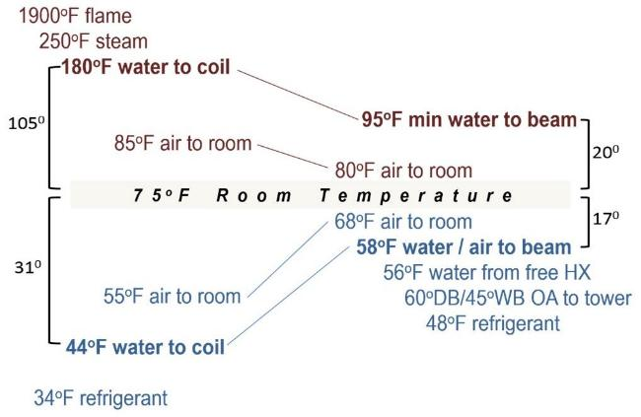
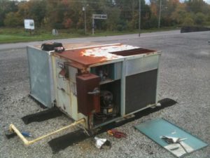
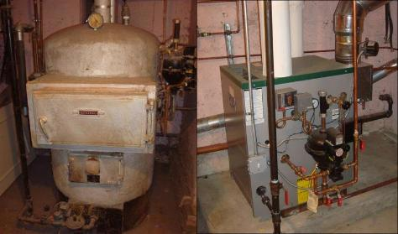
Matching Systems to Building Types
Influencing Factors
Climate Zone
Grid Emissions Profile
Load Profile
Distribution Temperatures
Type of Equipment

Slide 33
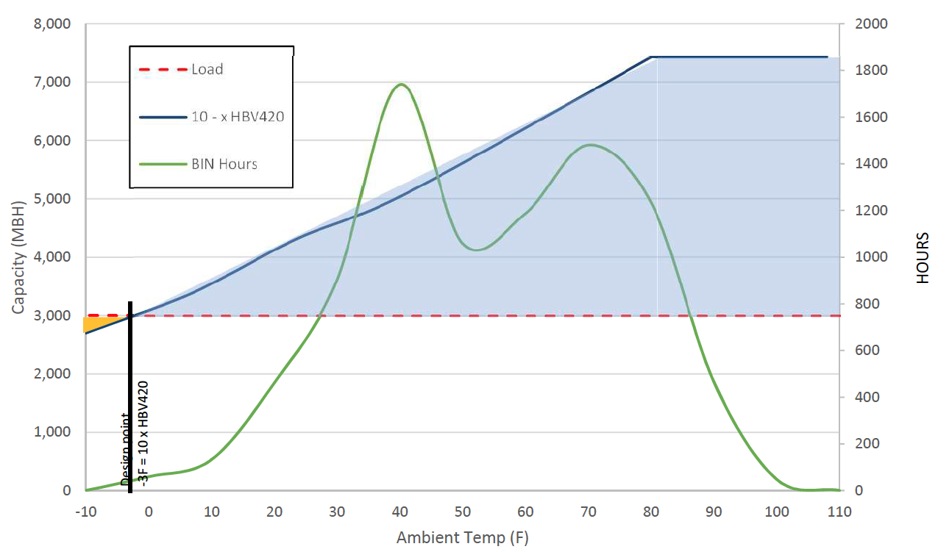
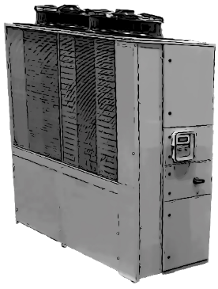
Heat Pump System Sizing, Chicago
Note that overcapacity in the blue area can be as much as 2.5 times the design load
Short cycling compressor runs
Nuisance trip on high-pressure alarms
Load
Capacity
BIN hours
Capacity (MBH)
Hours
Compressor Speed Adjusted
Image Source: Transom
Ambient Temp (°F)
Notes:
The typical winter design point is -5°F ambient
To match the load (3,000 MBH)
Multiple units would be needed
The capacity curve slopes down as ambient temp goes down.
The unit can still operate and produce heat below, but it will add up to the full load.
For this gap back up electric resistance heat is used. See YELLOW area

Slide 34
Long Beach Ambient Temperature TMY3
Heating system turndown ratios have always been important for stable control.
Heat pumps don’t change that requirement!

Slide 35
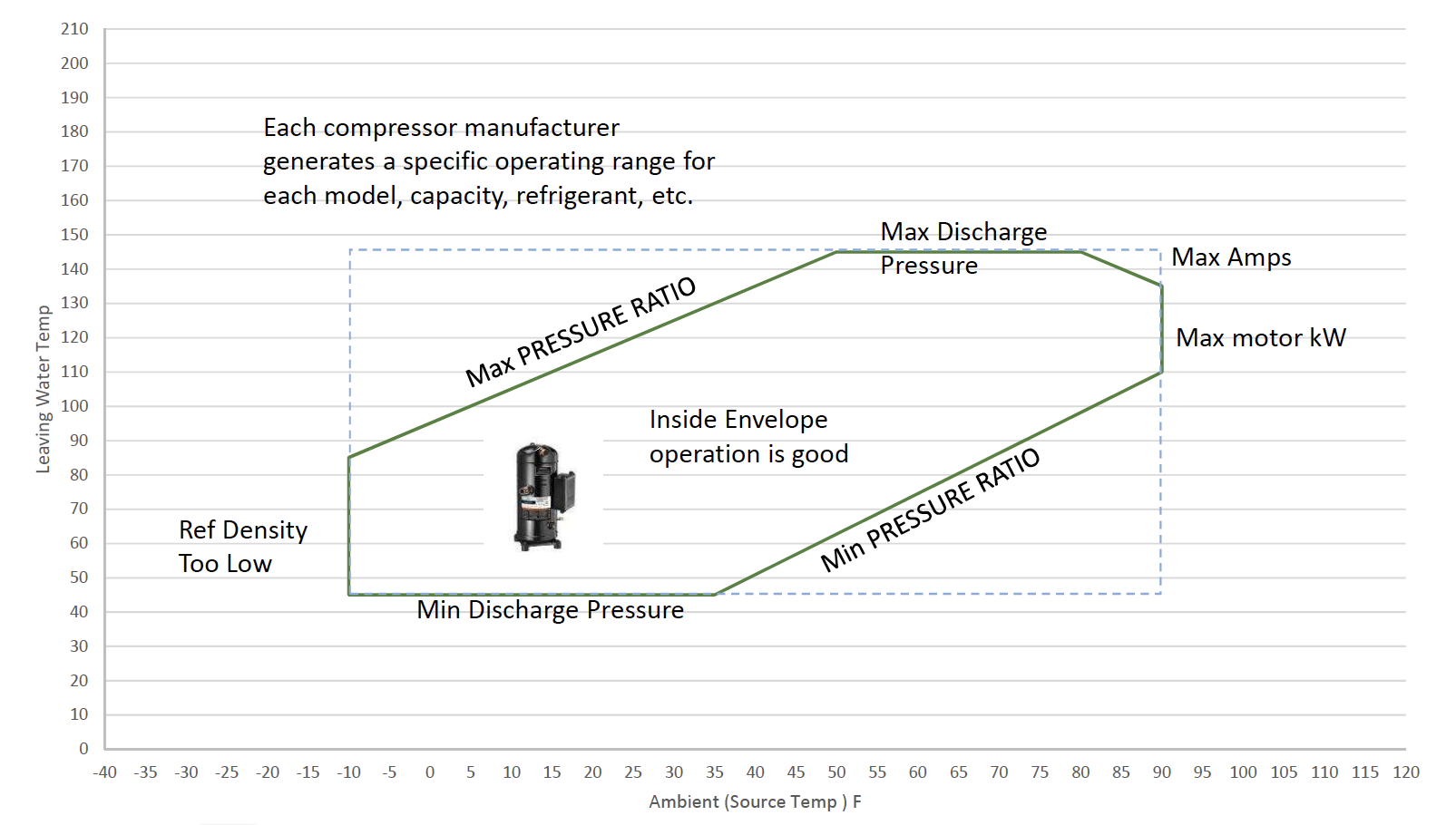
Understand the Operating Limits for ASHPs
Image Source: Transom

Slide 36
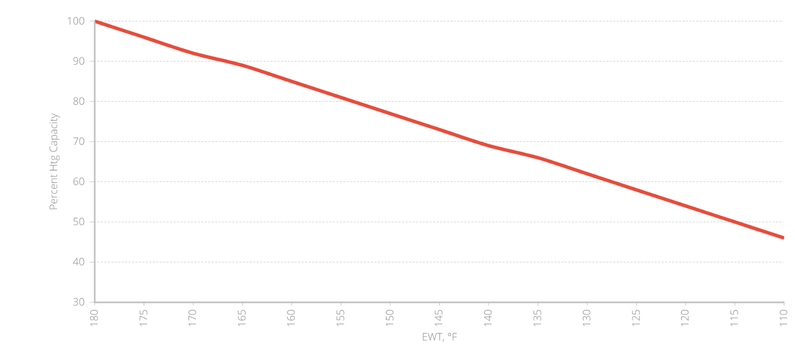
Lower Supply Water Temperatures
Reimagine HHWS Temperature Regimes
Medium Efficiency Equipment
Fewer Equipment Options
Highest Efficiency Equipment
Most Equipment Options
Terminal Device Heating Capacity
Lowest Efficiency Equipment
Nearly No
Equipment Options
Low Efficiency Equipment
Few
Equipment Options
Supply Water Temperature °F

Slide 37
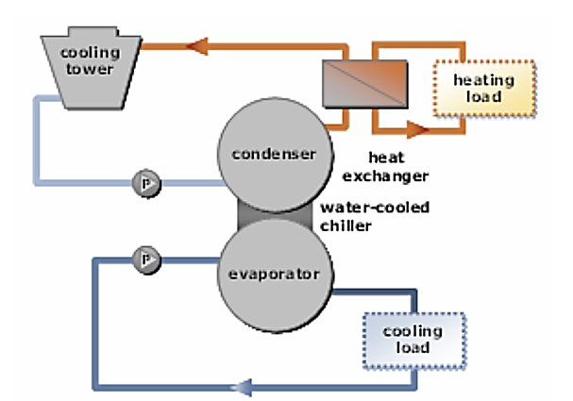
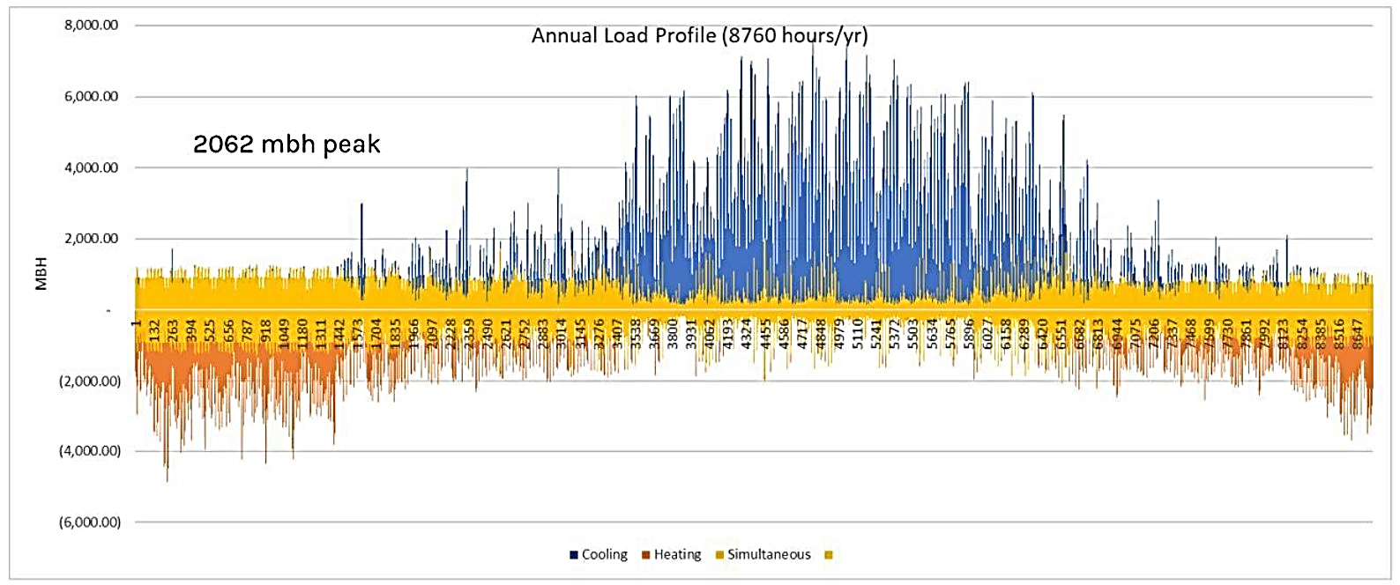
Heat/Energy Recovery
(Waterside)
Source: Image Courtesy SmithGroup

Slide 38
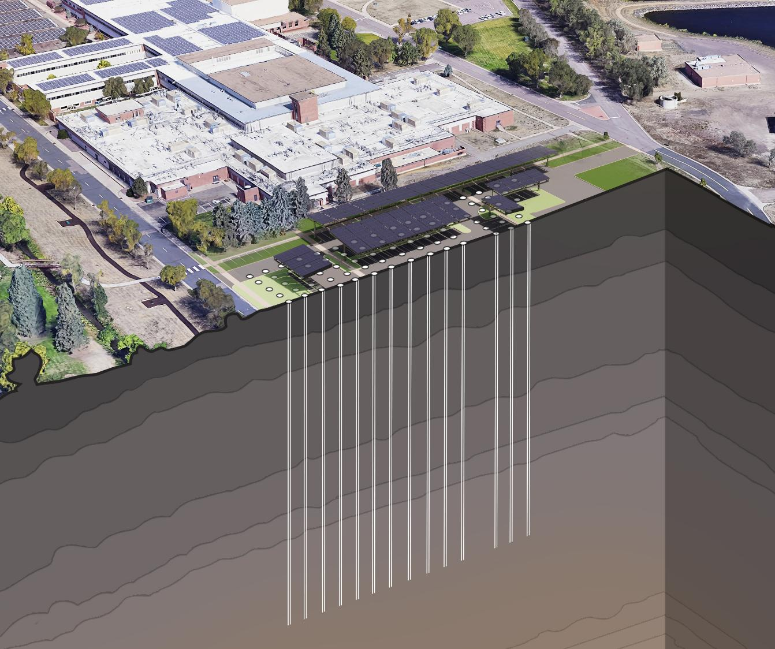
Right-Sourcing
(GSHP)
Source: Image Courtesy SmithGroup

Slide 39
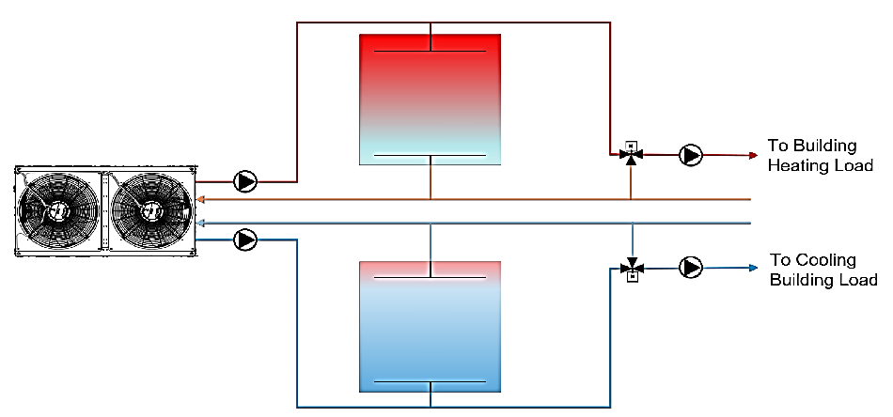
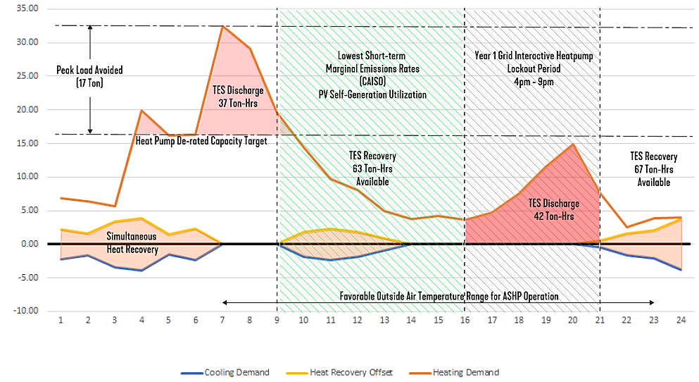
Advanced Heat Pump Strategies
(Pairing with Storage)
Source: Images Courtesy of SmithGroup

Slide 40
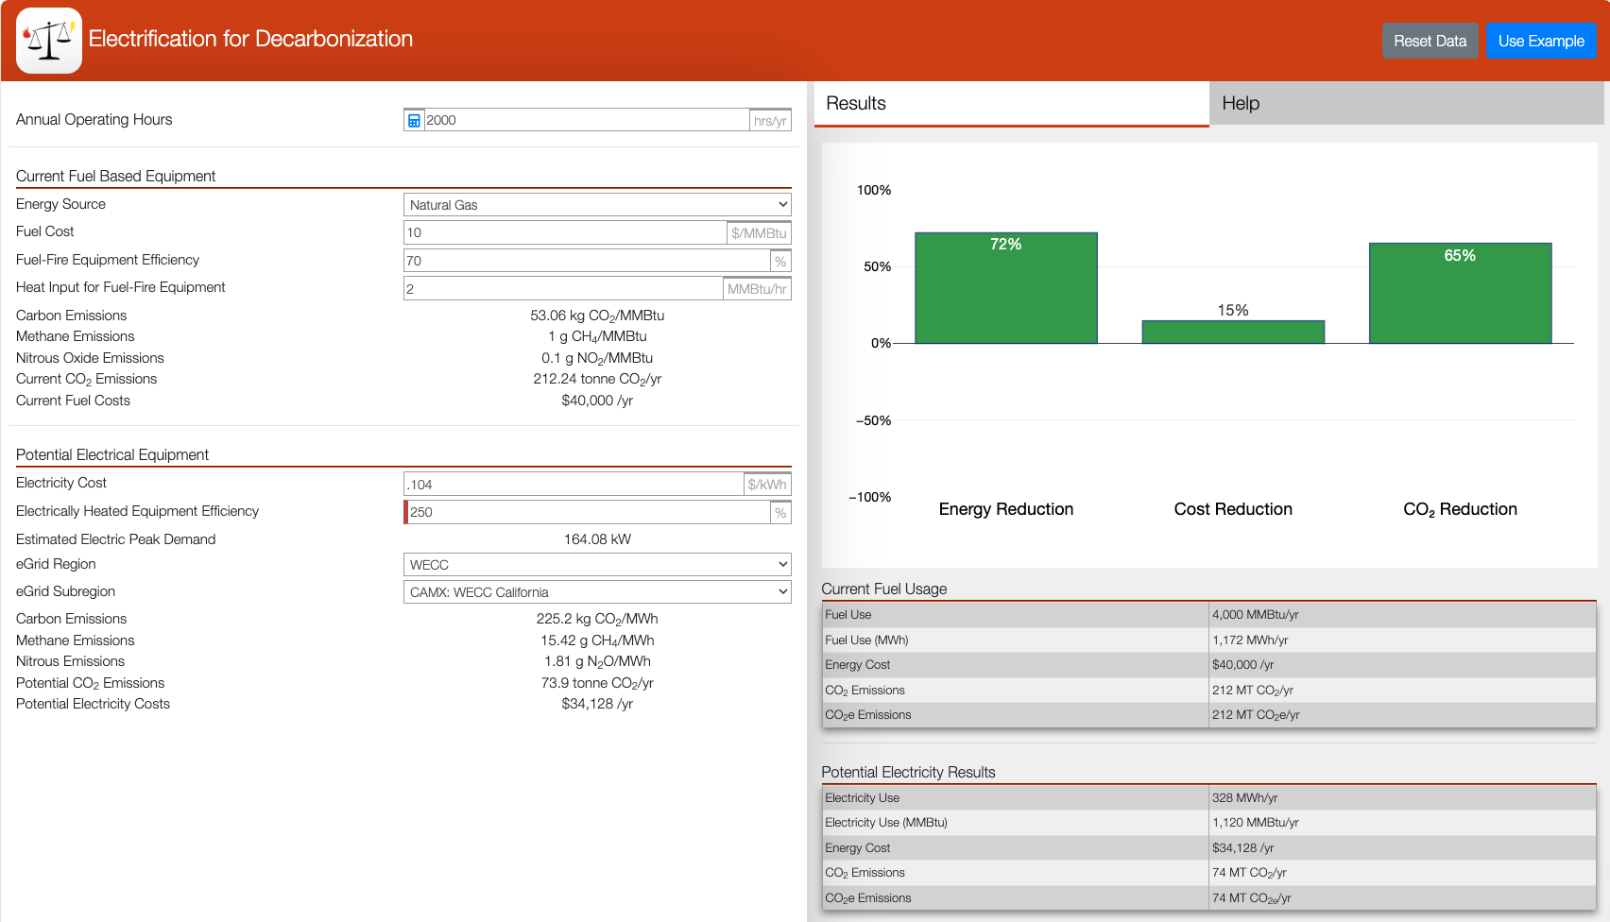
Target Utility Cost Parity and Emission Reduction
https://electrification.ornl.gov

Slide 41
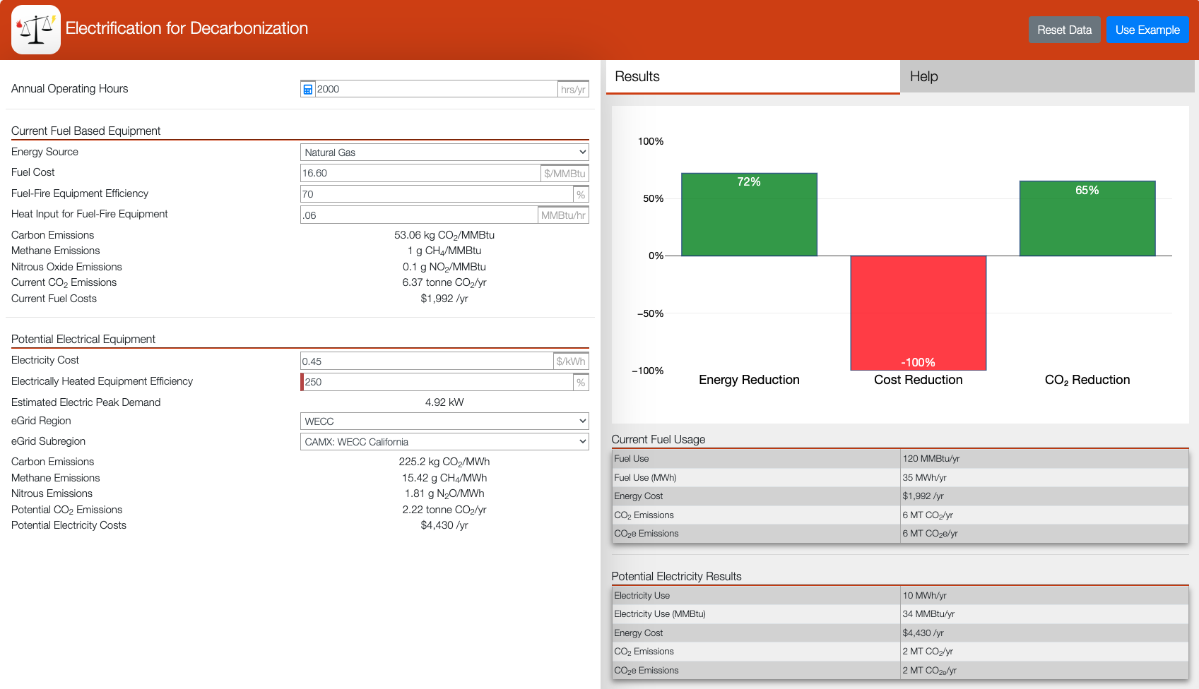
Target Utility Cost Parity and Emission Reduction
https://electrification.ornl.gov

Slide 42

Retrofit
Challenges

Slide 43
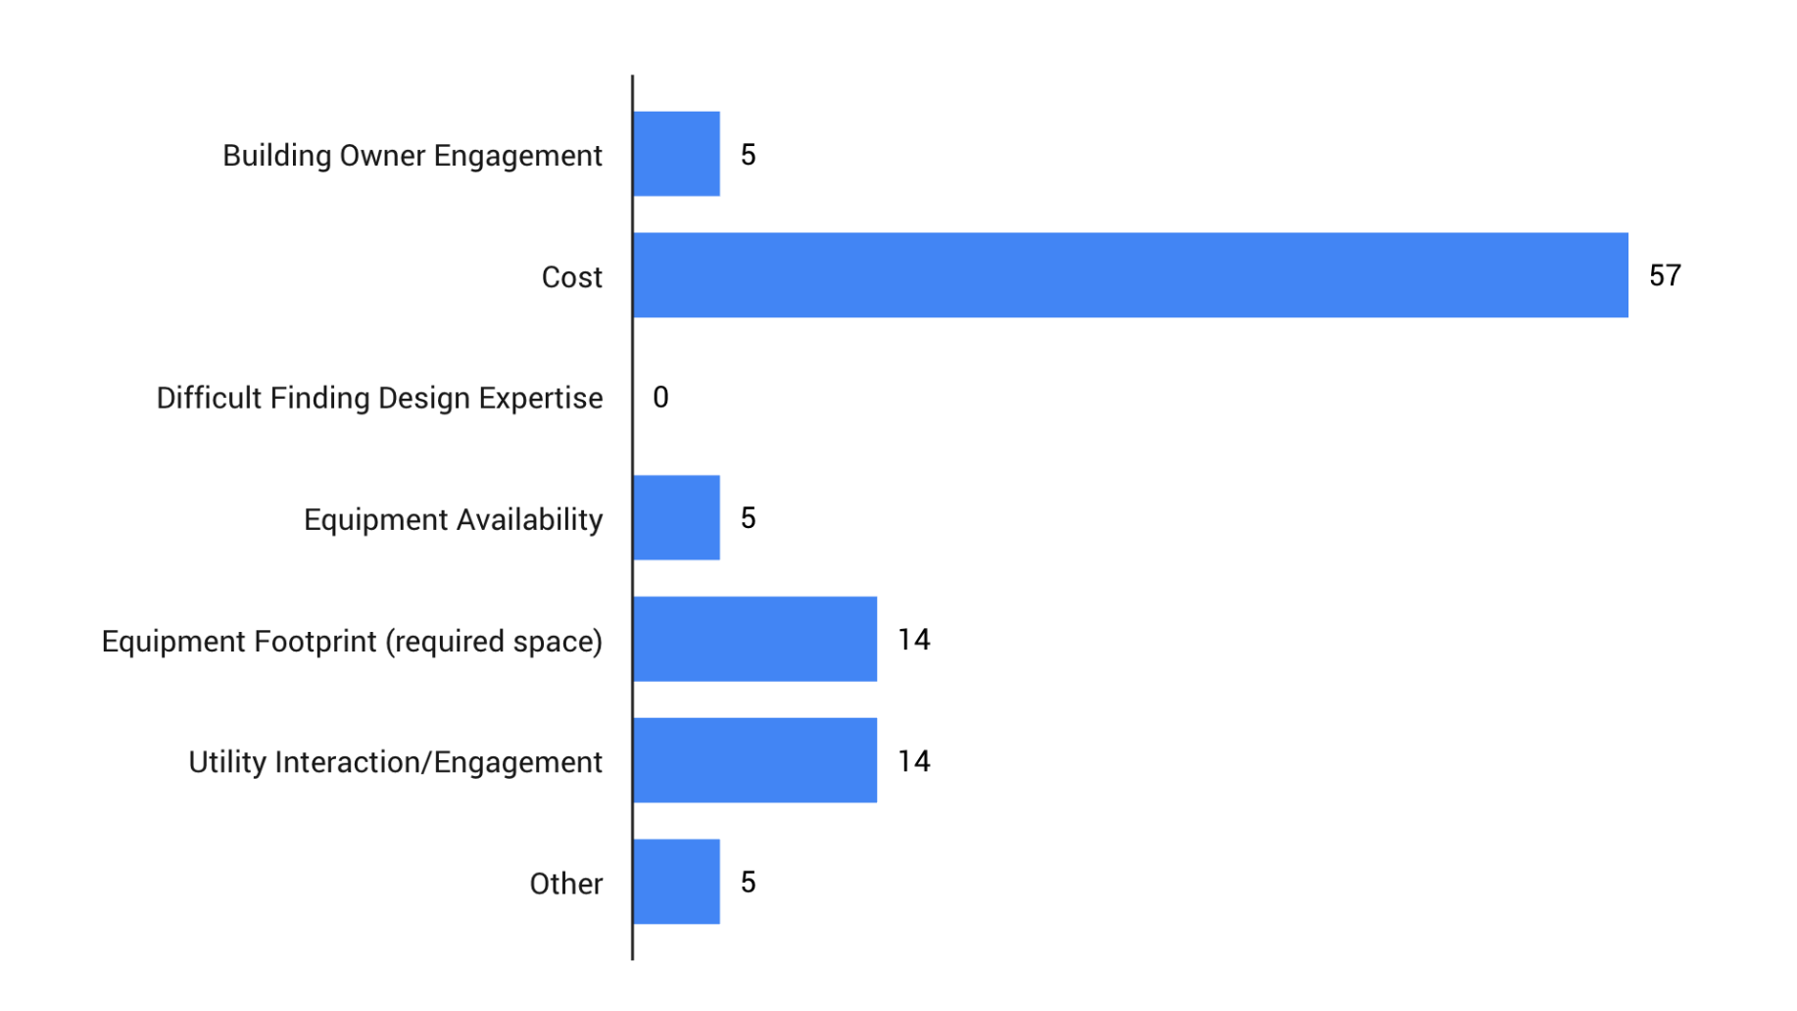
Electrification Retrofit Barriers
Source: PG&E Building Electrification Seminar

Slide 44
1 kWh/ft²-yr
80% of annual heating energy
consumption occurs when the load
is 25% or less
60-year-old building
125,000 ft² (11,600 m²)
Mild climate
Design 22 Btu/ft² (250 W/m²) peak
Actual 13 Btu/ft² (148 W/m²) peak
Notes:
We should strive to understand existing building annual heating load profiles before replacing boilers with electrical alternatives.
This example shows a 60-year-old building in a mild climate. Two years of trend data show the existing heating system was oversized. This is common with boiler systems.
80% of annual heating therms occur when the load is 25% or less of the installed capacity.
If the system were sized for the peak load experienced, 80% of annual heating therms would occur when the load is 42% or less.
If we are concerned about whole-life carbon, there will not be enough operational carbon savings in the lifetime of the equipment to electrify more than that 50%.
The incremental investment for the additional electrification doesn’t make sense.

Slide 45
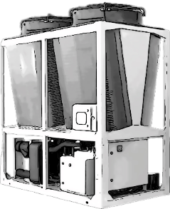



Notes:
If we are concerned about whole-life carbon, there will need to be more operational carbon savings in the lifetime of the equipment to electrify more than 30% of the design load if there is still life left in the existing boilers.
The incremental embodied carbon investment for the additional electrification doesn’t make sense.
We must understand existing building heating load annual profiles to decide how to optimally decarbonize existing hot water systems.

Slide 46
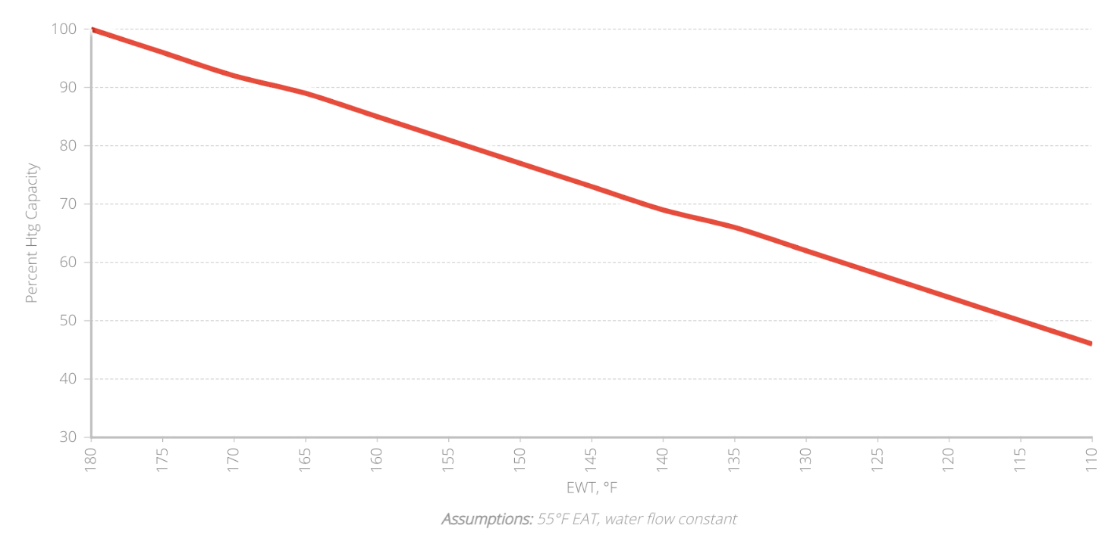
1-row VAV Percent Reheat Capacity vs. EWT
130°F could possibly meet the HHW loads in the previous example without changing piping or reheat coils

Slide 47
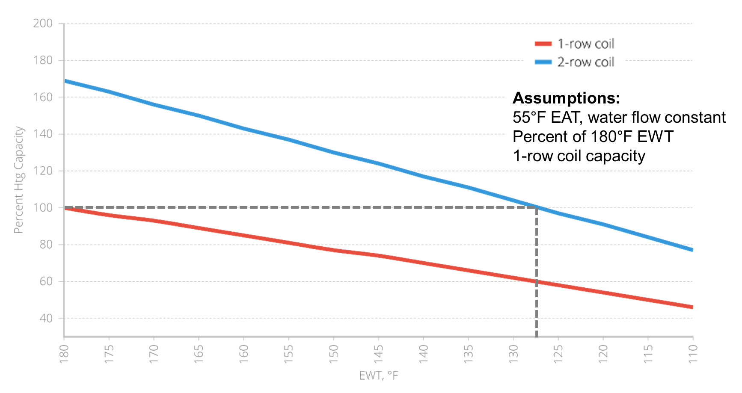
1-row VAV Percent Reheat Capacity vs. EWT

Slide 48
Decarb
Retrofit
Lessons
Learned
All GHG emissions matter (operational, embodied, and B1 refrigerants)
Decarbonization retrofits must reduce whole life GHG emissions

Slide 49
Determine actual peak heating loads and load profiles when decarbonizing existing heating systems
NEVER replace the same size equipment without first determining the actual needs of the existing building
Decarb
Retrofit
Lessons
Learned

Slide 50
Decarb
Retrofit
Lessons
Learned
There is a paradigm shift in the cost-effectiveness of heat recovery technologies with all-electric buildings
Building envelope and heat recovery options that were not cost-justified with boilers are now often economical with electrification retrofits.

Slide 51
Use minimum 2-row reheat coils when designing terminal reheat systems today
The future is low-temperature hot water to improve energy efficiency and exergy
Decarb
Retrofit
Lessons
Learned

Slide 52
Thermal storage is our ally (technical and economical) when providing heating solutions with hydronic heat pumps
Turndown ratios still matter in heating system design
Decarb
Retrofit
Lessons
Learned

Slide 53
Decarb
Retrofit
Lessons
Learned
Don’t be afraid of partial decarbonization strategies for meeting life cycle cost requirements
An 80% GHG emission reduction is better than NO reduction!

Slide 54


Center of Excellence for Building Decarbonization (CEBD)
Four Key Areas
Focused on strategy, thought leadership, industry collaboration, and public advocacy related to building decarbonization
Works with the ASHRAE councils to deliver projects
  Technology
  Education
  Research
  Standards

Slide 55
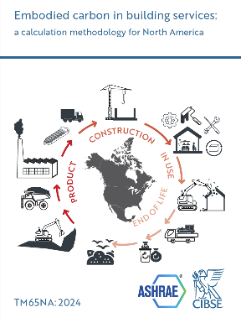
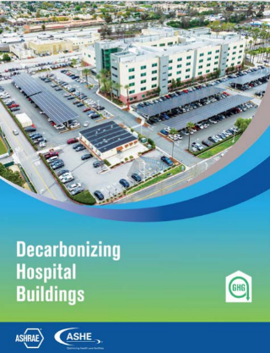

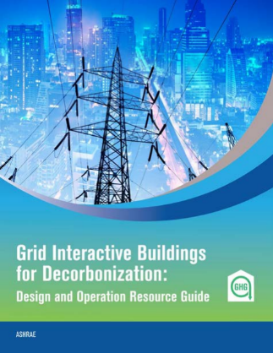


ASHRAE Published Decarbonization Guides

Slide 56



ASHRAE Decarbonization Guides
COMING IN 2025!
Expanded Version 2

Slide 57

Notes:
I will leave you with one thought: We can do better and develop solutions that minimize our impact on the environment.

Slide 58


Thank You

